Slide 1
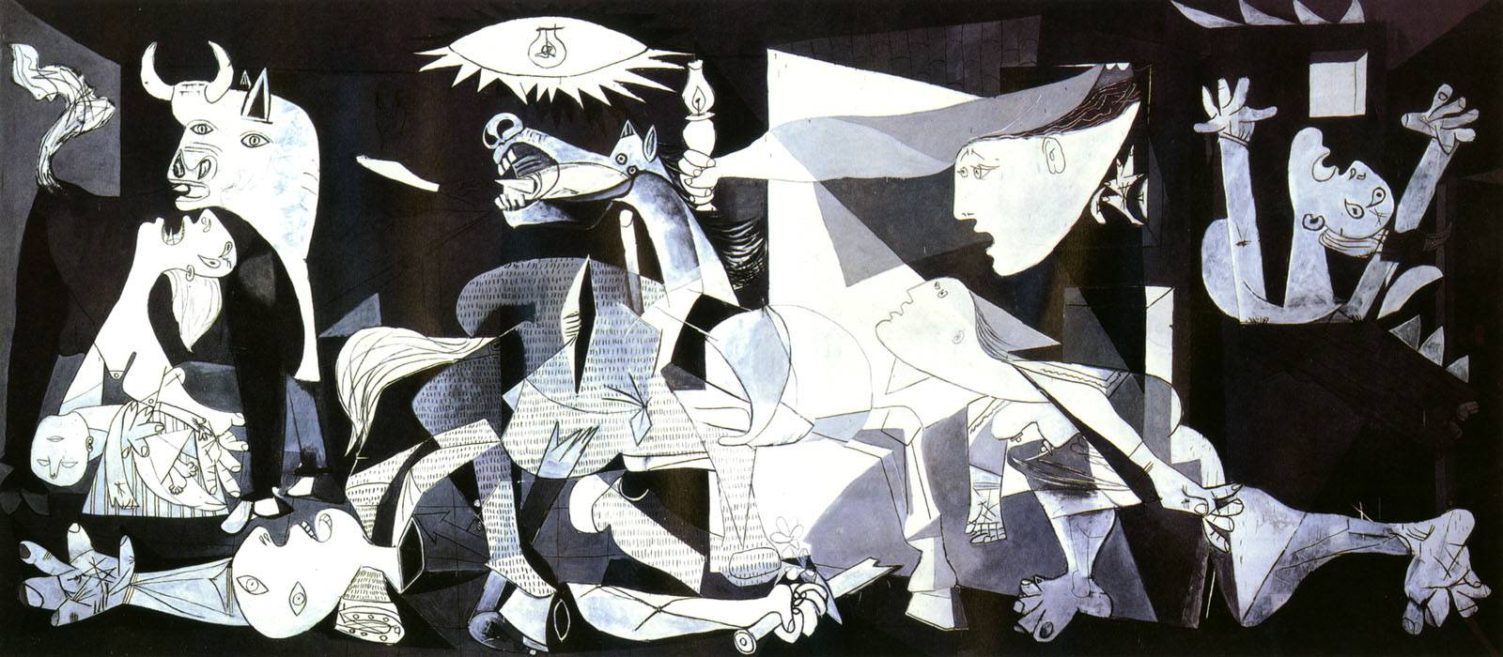
Guernica, 1937 by Pablo Picasso (Spanish, 1881-1973)
Oil Painting 11’ x 25.6’
Museo Reina Sofía , Madrid, Spain
Cubism
Viewlists Share

Slide 2
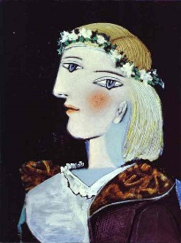
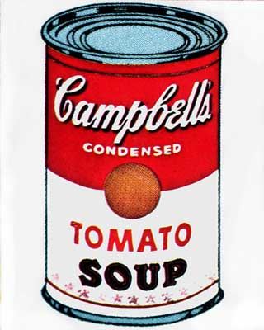
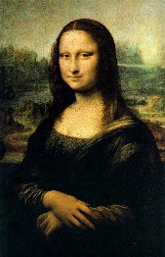
Viewlists
Edit
+
Picasso (212 images) by Pablo Picasso (1881-1973) considered one of the greatest and most influential artists of the 20th century, he is widely known for co-founding the Cubist movement, in invention of constructed sculpture, the co-invention of collage and for the wide variety of styles he helped develop and explore.
Pop Art (32 images) is an art movement that emerged in the mid-1950’s in Britain and in the late 1950s in the US. Pop art presented a challenge to traditions of fine art by including imagery from popular culture such as advertising, news, etc. In Pop art, material is sometimes visually removed from its known context, isolated, and/or combined with unrelated material.^{[1][2]} The concept of pop art refers not as much to the art itself as to the attitudes that led to it.^{[2]}
Old Masters (47 images) is a European painter of skill who worked before about 1800, or a painting by such an artist. In theory an Old Master should be an artist who was fully trained, was a Master of his local artists' guild, and worked independently, but in practice paintings considered to be produced by pupils or workshops will be included in the scope of the term.

Slide 3
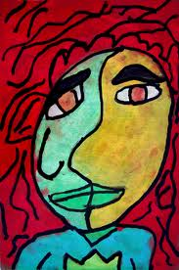
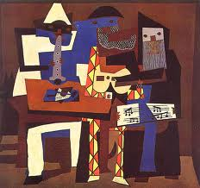
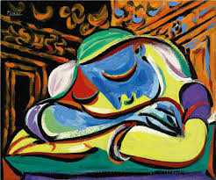
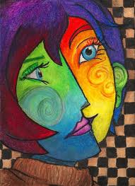
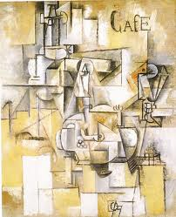
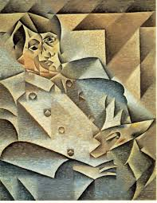
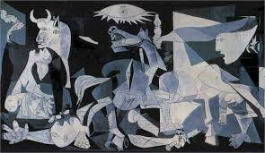
Pablo Picasso
Viewlists

